Slide 1

AWS Step Functions for Workflow Automation
K. Poojitha (2210030123)
Under the esteemed guidance of
Ms. P. Sree Lakshmi
Assistant Professor,
Department of Computer Science and Engineering

Slide 2
Project Overview
Problem Statement: Manual coordination between payment processing, order management, and shipping leads to inefficiency and delays.
Objective: Automate a multi-step order processing workflow using AWS Step Functions.
Real-World Relevance: Used in modern e-commerce platforms to streamline business processes like Amazon.

Slide 3
Services Used
AWS Step Functions: Orchestrates the entire order workflow.
AWS Lambda: Executes logic for each individual step.
Amazon DynamoDB: Stores order and refund data.
AWS IAM: Manages permissions and secure access to services.

Slide 4
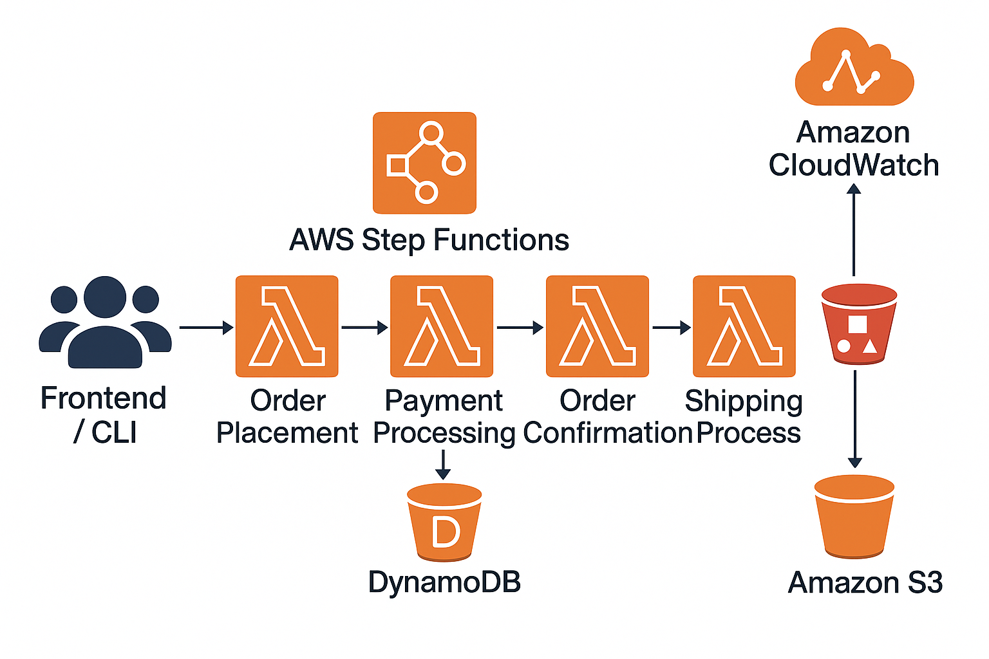
Flow Diagram
Architecture:
Tools: AWS Console

Slide 5
Implementation Process
Created Lambda functions (Python)
Designed Step Functions State Machine (ASL)
Integrated with DynamoDB
Configured IAM roles

Slide 6
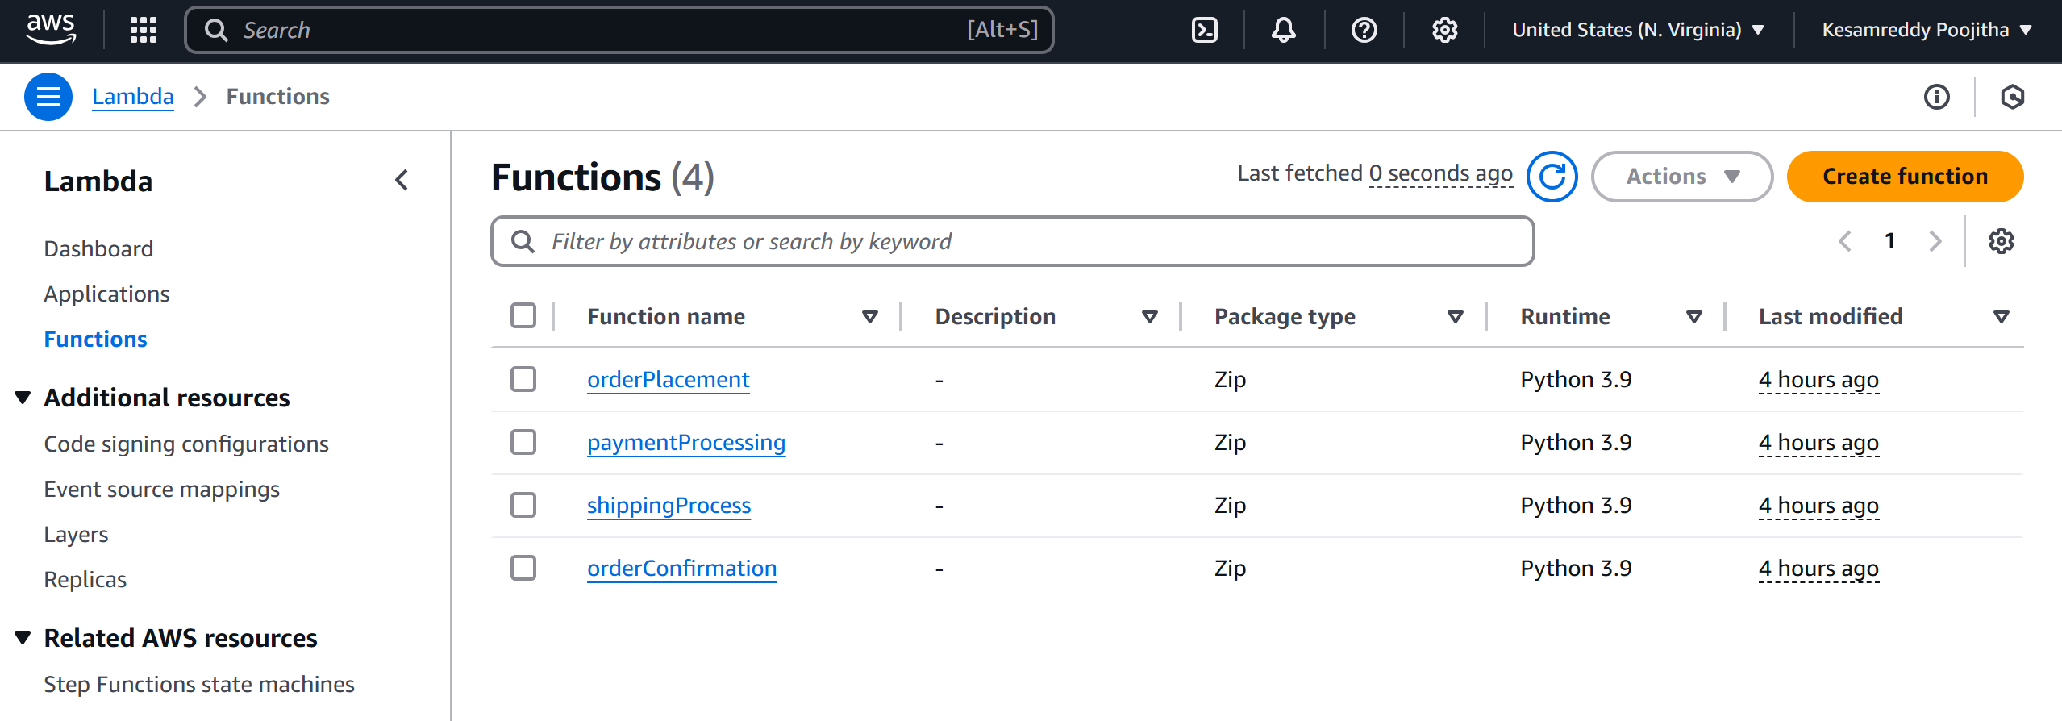
Created Lambda functions (Python)

Slide 7
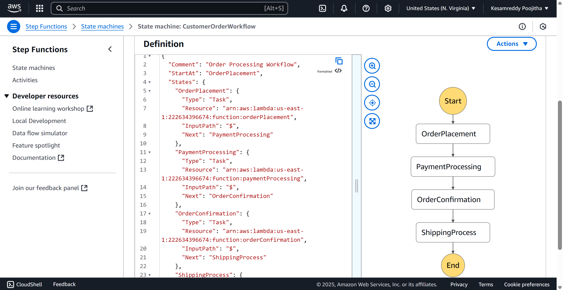
Designed Step Functions State Machine

Slide 8
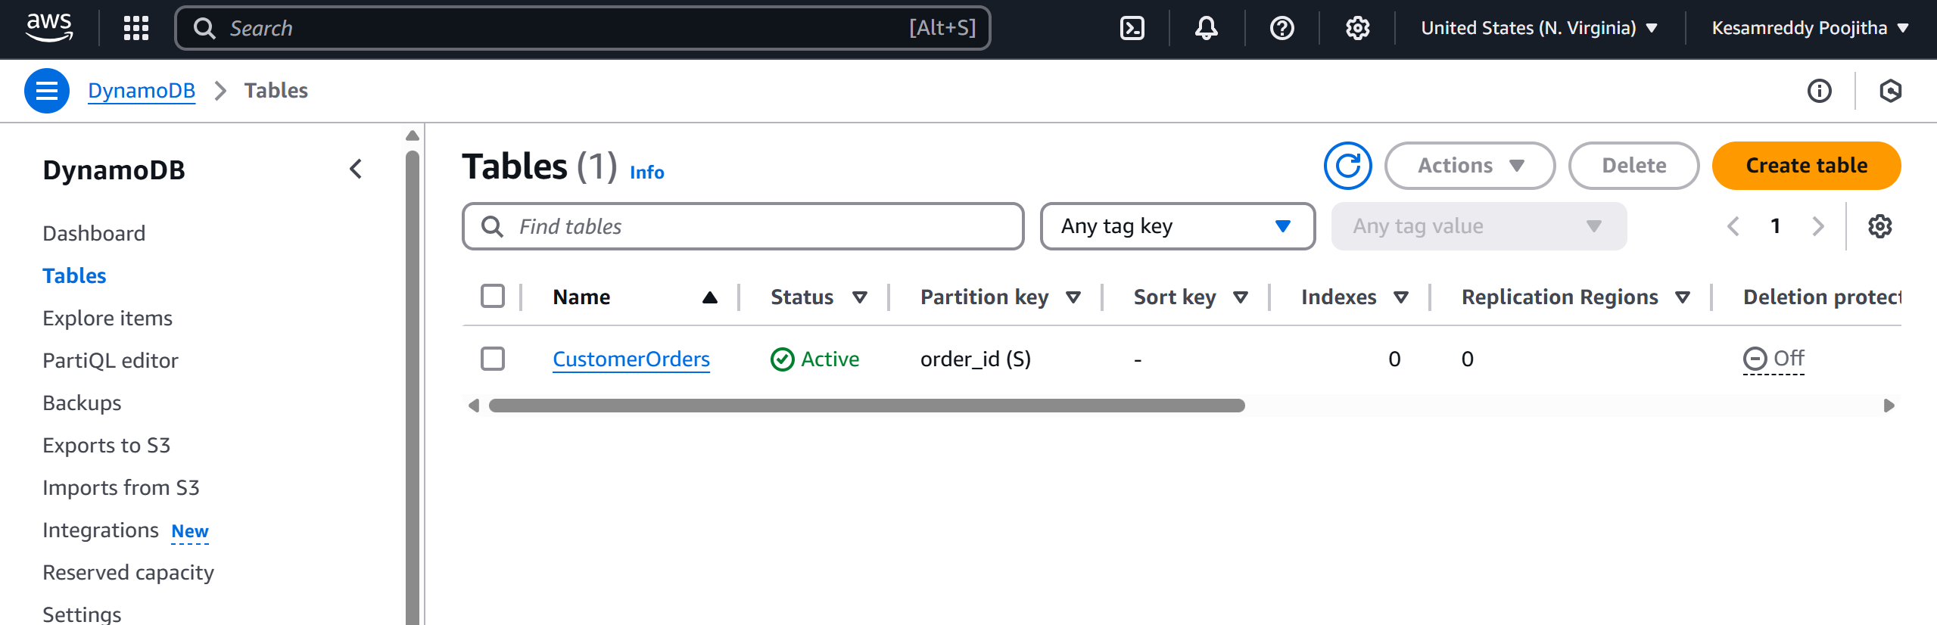
Integrated with DynamoDB

Slide 9
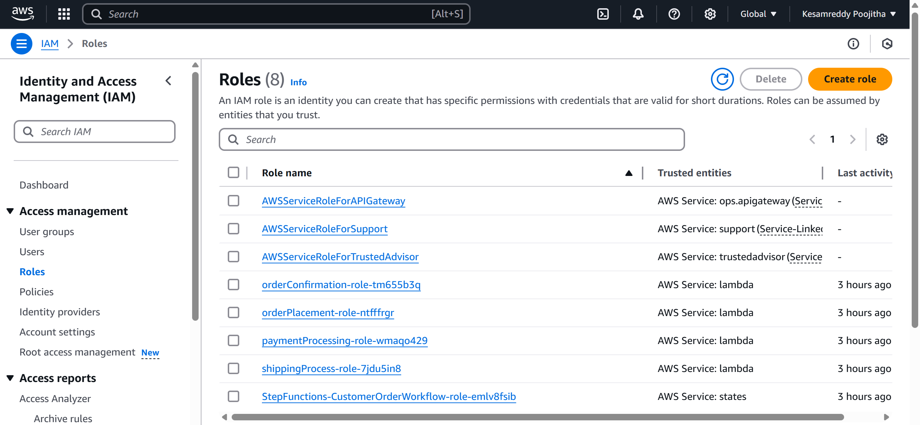
Configured IAM roles

Slide 10
Key Features and Functionality
Complete serverless order lifecycle automation
Conditional refund logic
Real-time DynamoDB updates
Cost-effective and scalable
Easy modular extension

Slide 11
Results and Outputs
Successful executions (logged via CloudWatch)
DynamoDB entries for each stage
State transitions visible in Step Functions
Metrics: 100% execution success rate

Slide 12
Challenges and Solutions
Debugging failed executions: Resolved via CloudWatch
IAM role complexity: Solved with least privilege principle
Refund logic handling: Implemented using 'Choice' state

Slide 13
Learnings & Takeaways
Technical: Step Functions, Lambda, IAM, DynamoDB
Soft Skills: Debugging, Planning, Documentation
Explored AWS certifications and hands-on practice

Slide 14
Future Scope
Add Amazon SNS for user notifications
Use API Gateway for external access
Cost optimization via Lambda tuning
Monitor workflow using CloudWatch Dashboards

Slide 15
References
AWS Step Functions Documentation: https://docs.aws.amazon.com/step-functions/latest/dg/welcome.html
AWS Lambda Developer Guide: https://docs.aws.amazon.com/lambda/latest/dg/welcome.html
Amazon DynamoDB Guide: https://docs.aws.amazon.com/dynamodb/latest/developerguide/Introduction.html
AWS IAM Documentation: https://docs.aws.amazon.com/IAM/latest/UserGuide/introduction.html
AWS General Documentation: https://docs.aws.amazon.com/

Slide 16
THANK YOU

